Slide 1


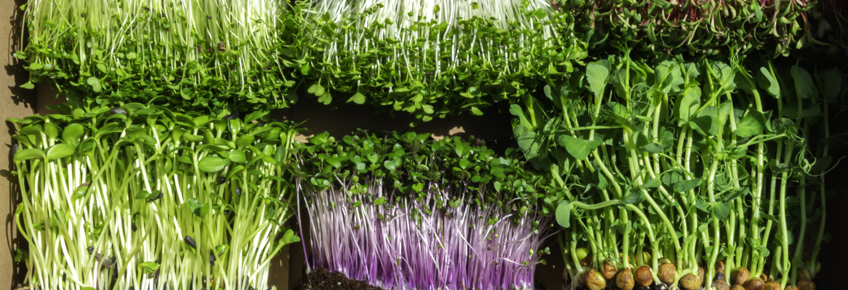
Have Seeds Will Travel
Welcome to the Ariadne Microgreens Project
All non-project images licensed to J Myerscough via stock.adobe.com

Slide 2
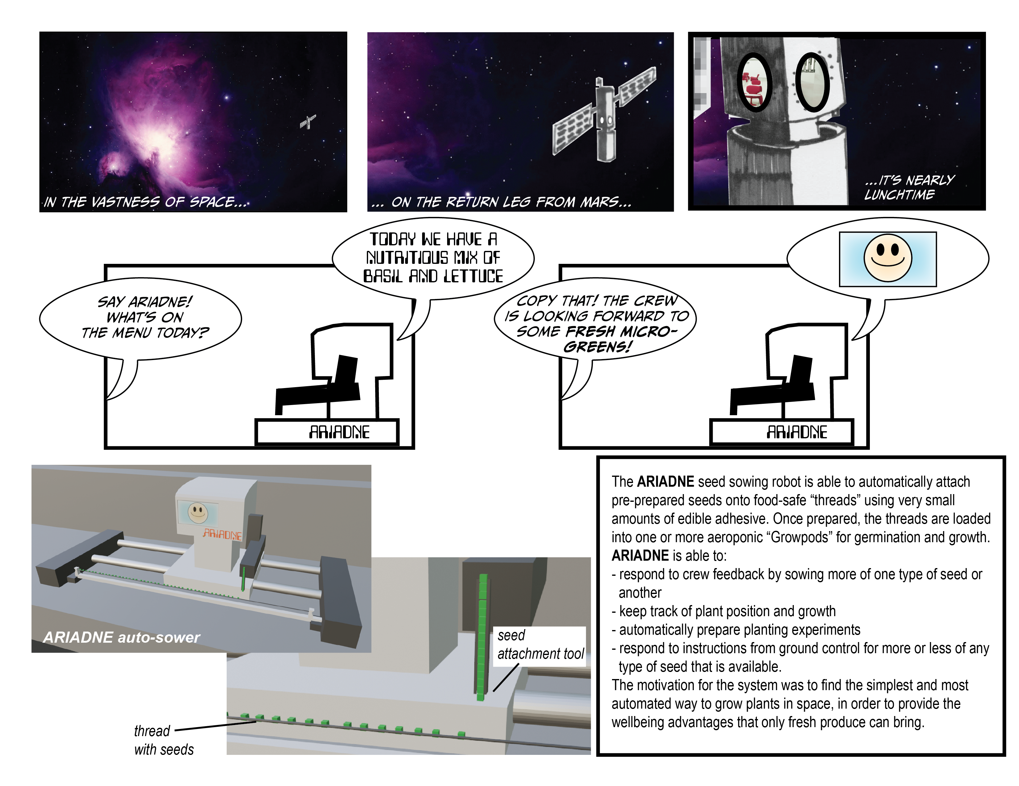

Slide 3
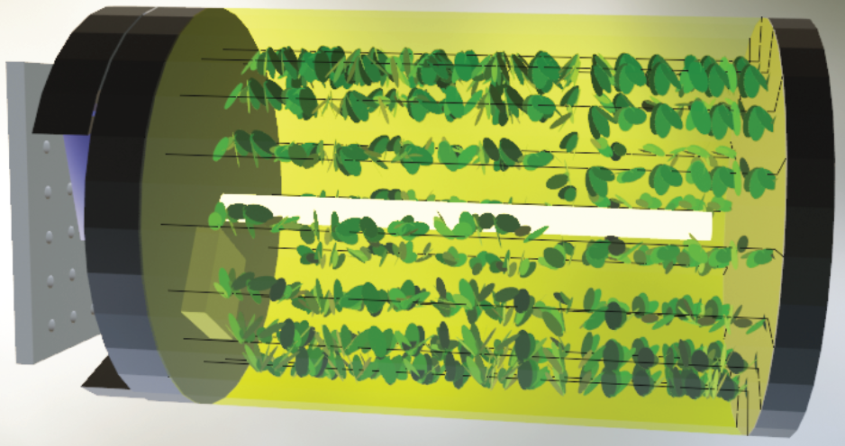
The Ariadne Growpod
Once prepared, threads are loaded into the aeroponic "Growpod", a slowly rotating pod that contains an aeroponic fogger system for keeping microgreen seeds/roots at just the right moisture level. Water and nutrients are provided via a refillable pouch at the mounting side of the system.
Sowing/growing automation allows for rapid iteration and experimentation without undue burden on the crew, while still providing crew with nutritious fresh food.
Precise adjustment of plant mix and distribution according to crew preferences or experiment parameters.
Cameras and sensors inside the pod allow remote data collection and analysis
Why the growing pod? Easy to store in small space until needed. Multiple pods can fit "Russian doll" style inside each other when stowed.
Designed to be easy to clean between use by keeping surface area to a minimum. Pod made of polycarbonate.
Parts are as simple as possible to allow crew maintenance and repair.
Harvesting
When a thread of microgreens is ready for harvesting, the crew simply removes then end cover and pulls out the desired microgreen thread. The leaves and parts that are edible can simply be removed, while roots can be slid off the thread for disposal, or for freezing and later analysis, leaving very little waste.

Slide 4
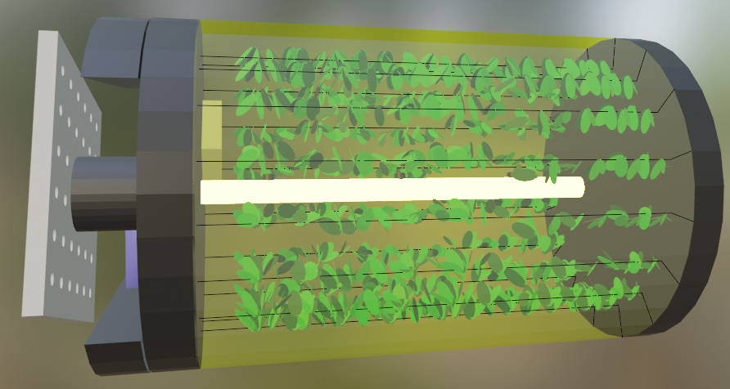
Ariadne Growpod (detail view)
Mist Flows back along inner surface of the pod to back pump
Air circulation fan
The Pod will rotate slowly along its access to provide a "gravity" gradient, directing mist to the roots of the Micro Greens.
LED and camera boom, White, Green, Blue, Red, Far Red, Infra Red. As Per APH.
With an size of approximately 100cm length, 50cm diameter, the pod will take little space. Power use 10-20 W total weight 2.5kg
Main Controls; Computer, sensors for temp, humidity, water levels, reverse pump to take water back into tank.
Water/nutrients pouch attached to mister/reservoir
Removable access cover
Mounting Point and power.
Threads with seeds (initially) then producing/growing Micro Greens with mixed crops being grown at any one time.

Slide 5
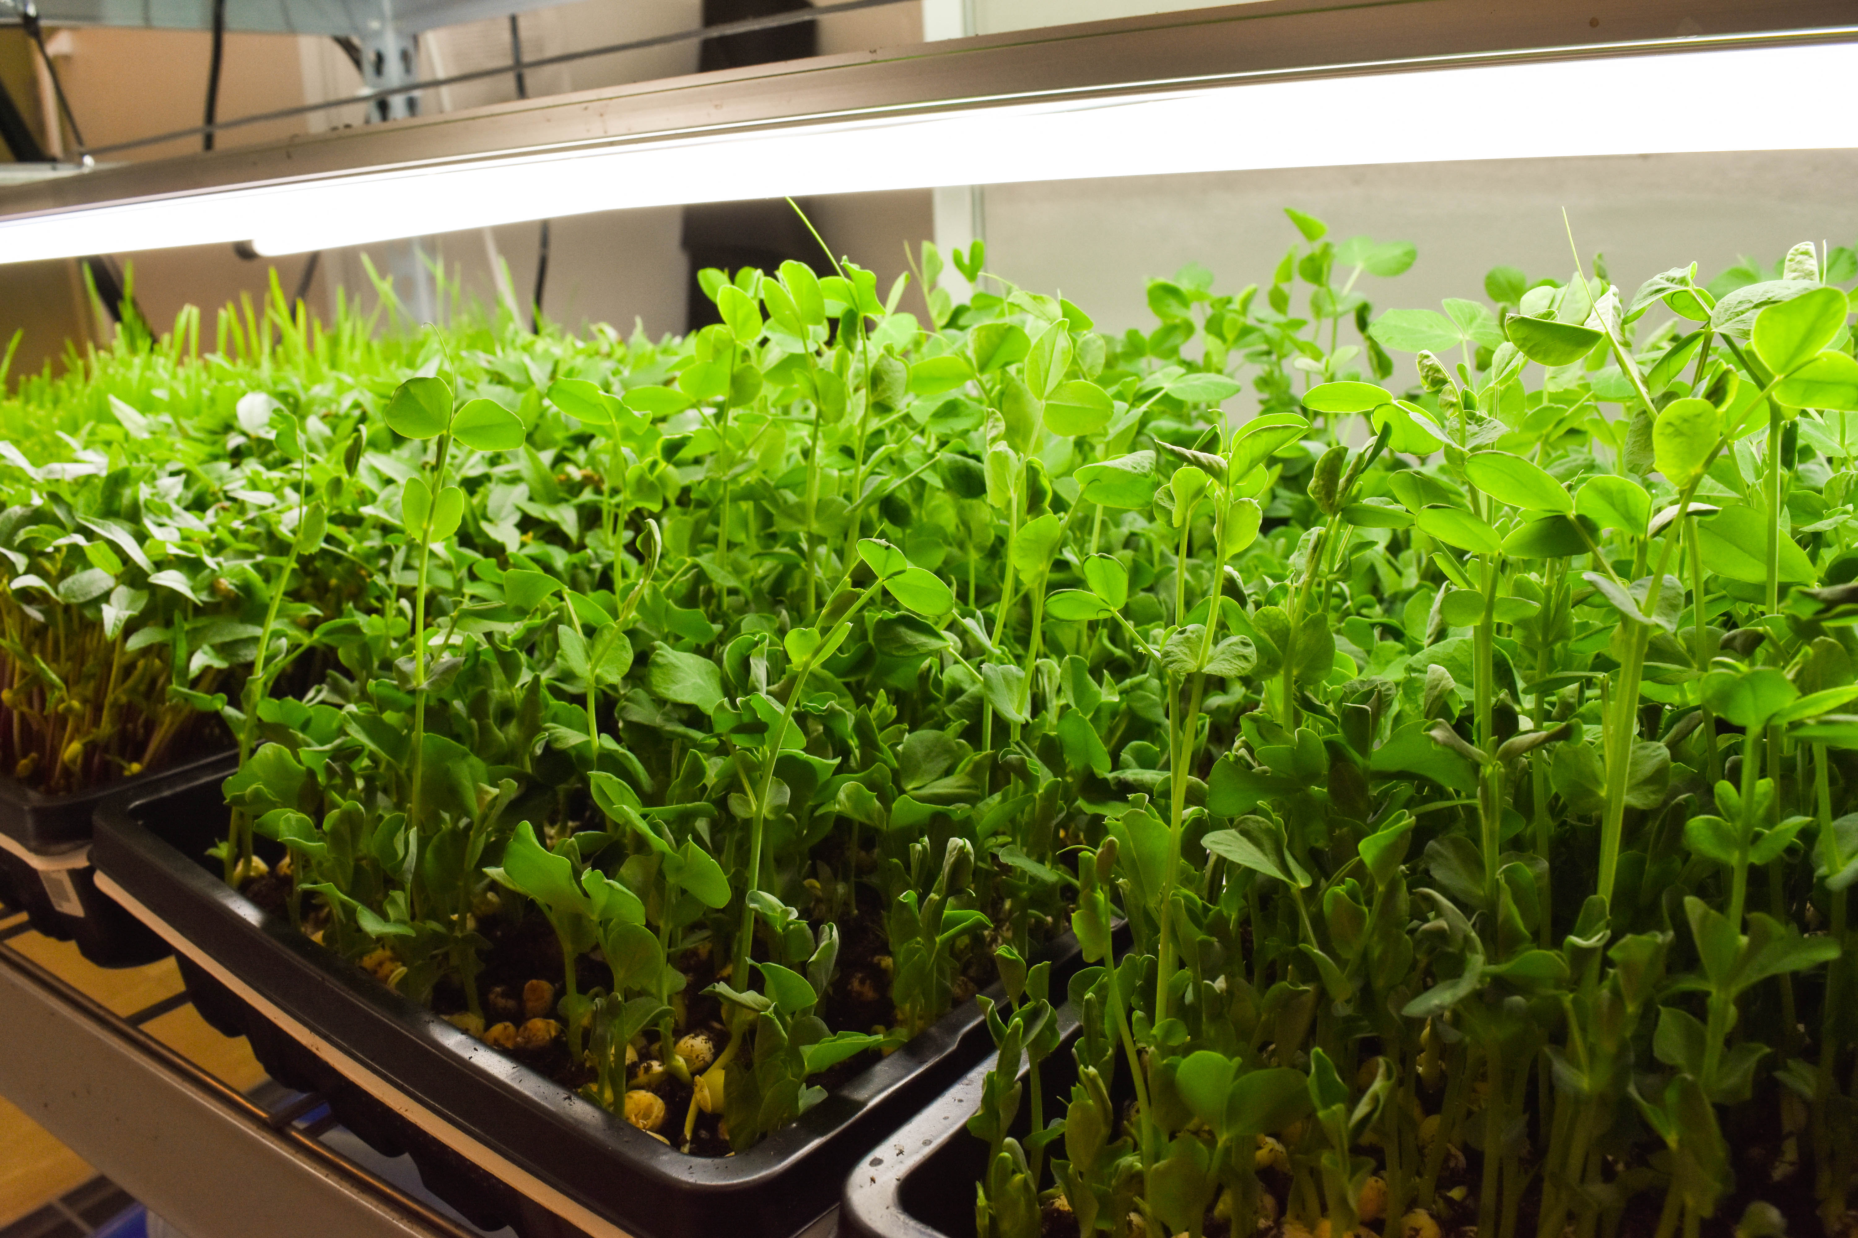
Threads, and why we chose microgreens
Micro Greens are incredibly fast growing, delivering
fresh sustainable food within a matter of days:
They can deliver high concentrations of vitamins, minerals, antioxidants (Niroula et al., 2021) and selenium (Newman et al., 2021).
Quick turn around means that fresh food can be supplied regularly.
There can deliver psychological benefits as well as nutrition benefits, with more aromatic taste than dried food.
Potential increase in radiation protection from certain fresh plants such as Amaranthus
Simpler to grow than larger plants
Why the Growpod?
Easy to store in small space until needed.
Easy to clean between use by keeping surface area to a minimum.
Easy to load and unload seeds/plants.
Thread system allows automation of sowing seeds. Manual sowing also possible
Thread system allows easy removal of plants with virtually zero waste.
This Photo by Unknown Author is licensed under CC BY

Slide 6

Nutritional Advantages..
Health Benefits Achieved - Potassium- regular heart beat, moving nutrients into cells and the waste out. Iron - red blood cells, carrying Oxygen. Zinc - assists Immune system and metabolism. Magnesium - Supports muscle, nerve function, energy production. Copper- assists connective tissues, blood vessels. Antioxidants- protecting cells against free radicals especially Radiation! Quinoa - high in Anti inflammatory Phytonutrients, Omega-3, Fennel - supports heart health helps to reduce Cholesterol, Garlic - Vitamin B-6 and C can help quell inflammation. Crops including Amaranthus actually help protect the consumer from Radiation.

Slide 7
Ariadne Microgreens Project brought to you by: Julian Myerscough Katherine Jones References Niroula, A. et al. (2021) ‘Pigments, ascorbic acid, total polyphenols and antioxidant capacities in deetiolated barley (Hordeum vulgare) and wheat (Triticum aestivum) microgreens’, Food chemistry, 354, pp. 129491–129491. doi: 10.1016/j.foodchem.2021.129491. Alina Petre (March 6 2018) Microgreens all you ever wanted to know, Healthline.com Rachel G. Newman et al. (2021) ‘Biofortification of Sodium Selenate Improves Dietary Mineral Contents and Antioxidant Capacity of Culinary Herb Microgreens’, Frontiers in plant science, 12, pp. 716437–716437. doi: 10.3389/fpls.2021.716437. Nasa.gov ‘growing plants in space’
Final words.
NASA research has identified a need for fresh vegetables for health reasons
and also pioneered the methods for studying plant growth in space. Samples are stabilised and stored for further study back on the Earth which will further improve Ariadne and her capabilities going forward in providing fresh food for longer, improving health and psychological wellbeing

